Slide 1
Diamond Price Prediction
This is a document to demonstrate the steps of the Diamond price prediction project

Slide 2
End to End ML Project
Below are the steps for end to end machine learning project, and in this document we will demonstrate how to apply it on our project.
look at the big picture
Get the Data
Discover and visualize the data to gain insights
prepare the data
Select a model and train it
Fine-tune the model
Present & Evaluate your model

Slide 3
1-Look at the big picture
This project is a Machine Learning Diamond price project our task is to use the data provided in the competition the train a model that best predicts the diamond prices.
Our model should learn from this data and be able to predict the diamond prices provided in the test data set.

Slide 4
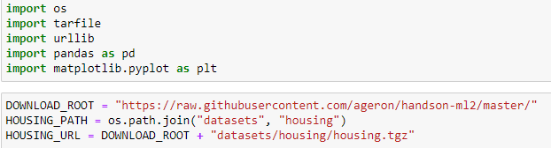


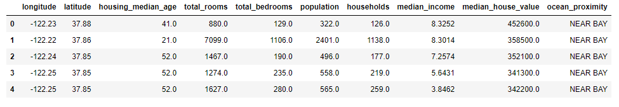
2- Get the Data
We will first download the desired dataset from it’s source.
Then we will use pandas to import the dataset

Slide 5
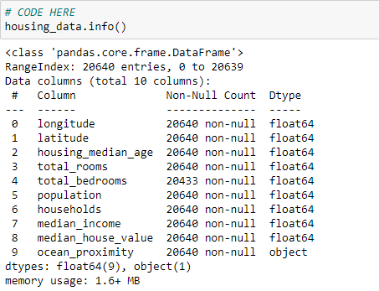
2-Discover and visualize the data to gain insights
Verify the quality of the data, check for missing values, duplicates, and inconsistencies (we can see that the total number of bedrooms has some missing values using the info function).

Slide 6
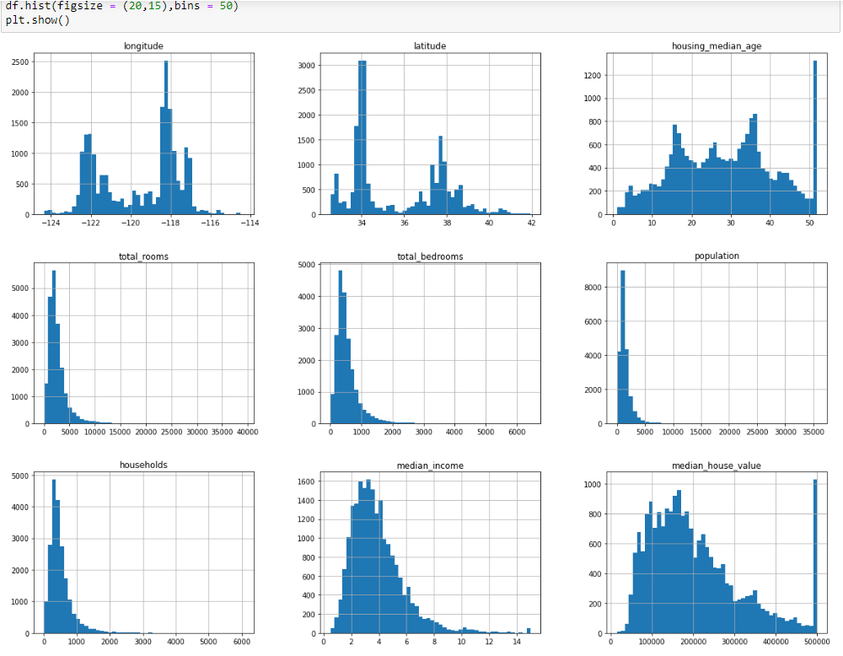
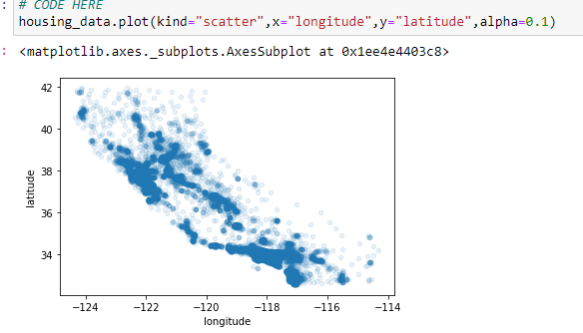
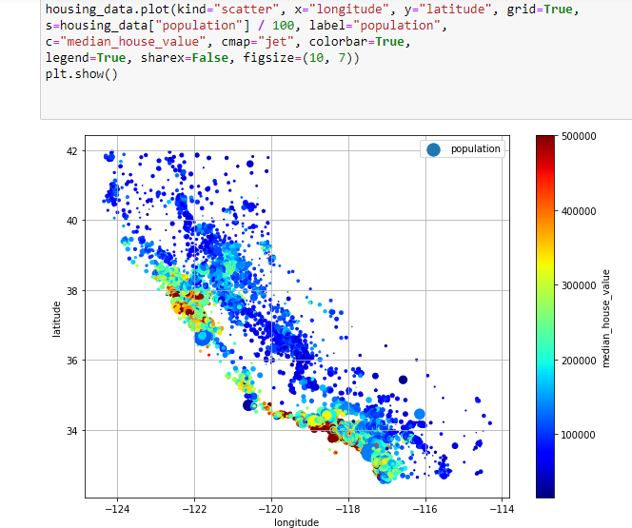
Using the pandas hist function we can view all the data distributions
and get to know our attributes.
By building a scatter plot between longitude and latitude with alpha =0.1 we can view the high density population areas.
And by tweaking the parameters to show the population as the radius and the price as color we get the below graph

Slide 7
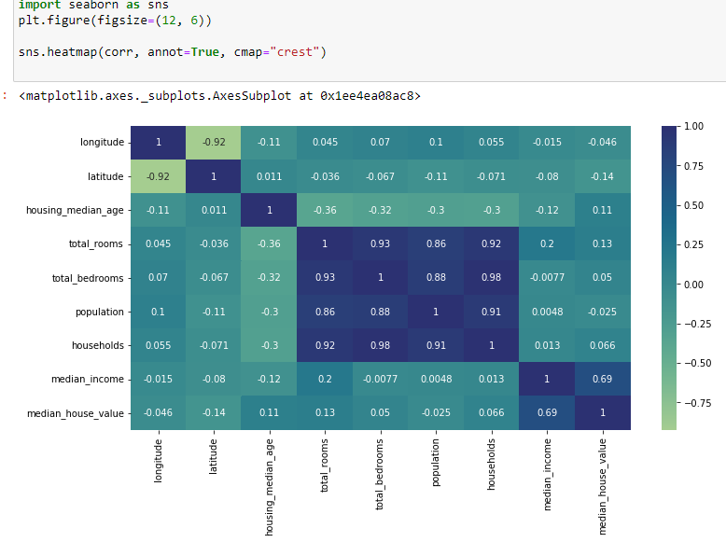
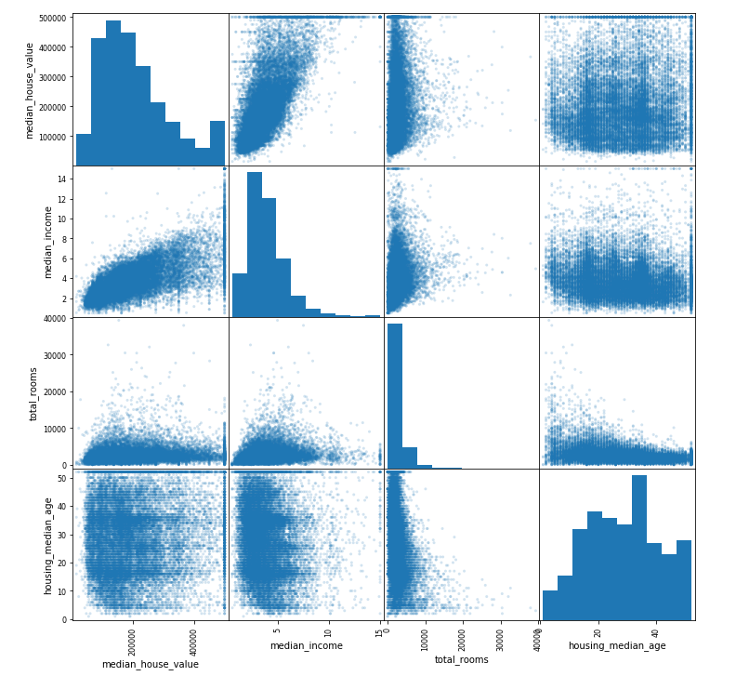
Measuring the correlation between attributes to know the relationship between them and which attributes could benefit us to predict our class variable this could be done using correlation matrix or scatter matrix
We can see below that median_income is highly correlated with the median_house_value

Slide 8
3- Prepare the data
Handle missing values: impute or delete them, (we found during our exploration that the total_bedrooms has some missing values), So we will fix this by replacing the missing values with the median using fillna

Slide 9
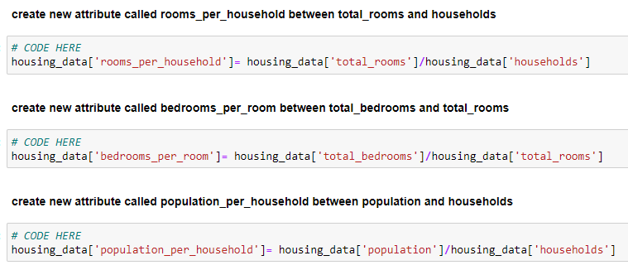
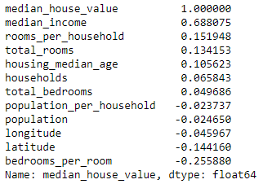
3-PREPARE DATA
Feature engineering: we experiment a little with our data to see if we could come up with new attributes.
Looking at the data there are a few variables we could create as shown below
Seems the new data are more correlated with the housing price more than the old attributes.
We can then drop old attributes using pandas drop function.

Slide 10

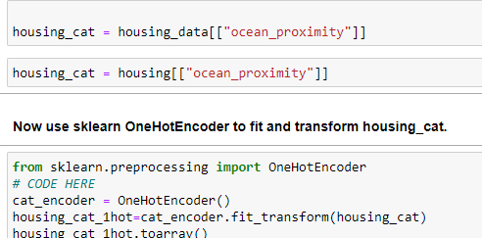
3- Prepare the data
Part of preparing data is dealing with categorical values “ocean_proximity”
Typically we will need to use an encoding method to transform the categorical values to numerical like the one hot encoding method which means we will create a Boolean flag for each distinct value in the categorical field.

Slide 11
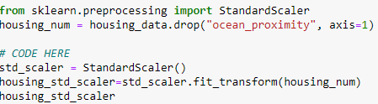
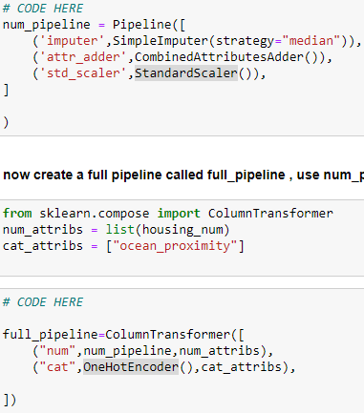
Standardizing data: we will use the standard scaler class to create a balanced numerical values across all numerical attributes
We will combine all the operations we did into a single pipeline for ease of use
We can then use it on our data as below

Slide 12
4- Model Selection and Training
Select appropriate machine learning algorithms (e.g., linear regression, decision trees, random forests, etc.) based on the nature of the problem (regression or classification).
Our task is that of regression so we need to try out models related to regression.

Slide 13
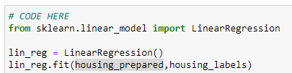
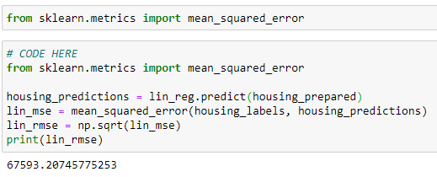
LINEAR Regression
We can easily implement it using the scikit learn library
We will try it out on the training data and then we will measure the error rate using the rmse method :

Slide 14
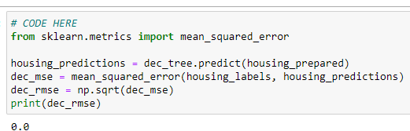
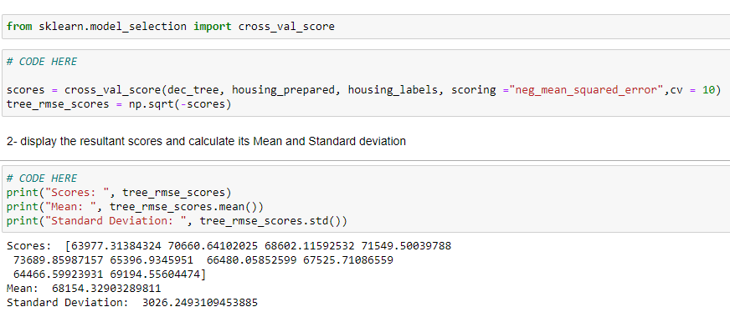
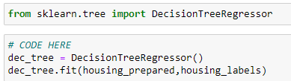
Decision tree
We will do the same using decision tree
Seems that the decision tree has badly overfit the training data so the error is now 0 so we will evaluate instead using the cross validation method which is more efficient than testing the model on the training data

Slide 15
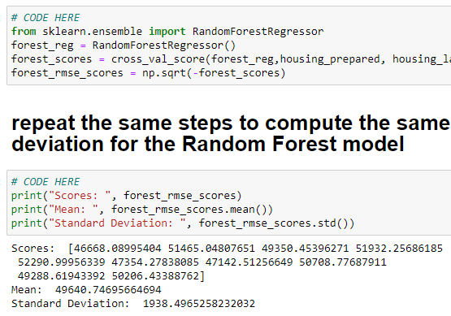
Random forest
Lastly we will do the same using random forest model.

Slide 16
Saving final model
Finally after choosing a model that performs best we will save it to use it later.

Slide 17
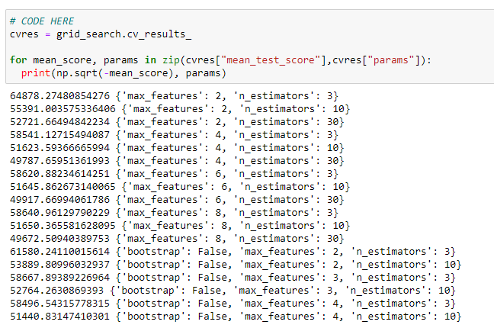
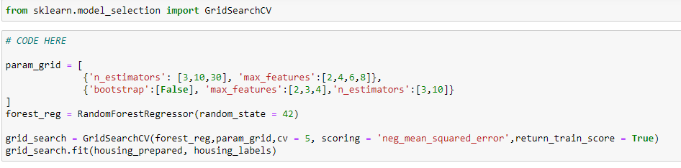
Fine-tune the model
Next we will need to finetune the model for that we will use the grid search method to find the combination of attribute values that produces the least error as shown below.
Looking at the grid search results we can see the best parameters for our models as shown below:

Slide 18
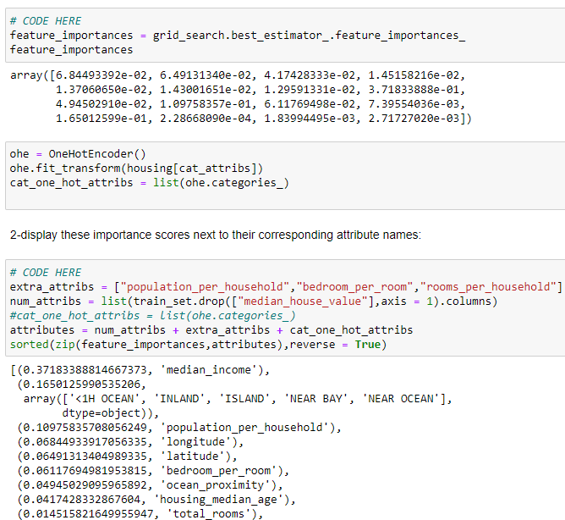
Present & Evaluate your model
We will present the attributes importance from the grid search as shown below:

Slide 19
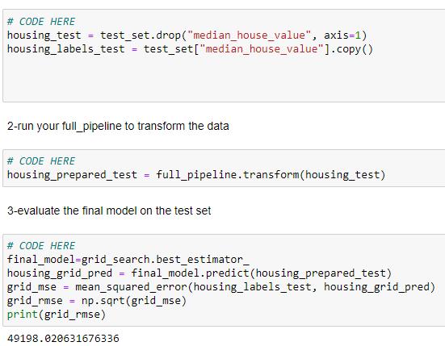
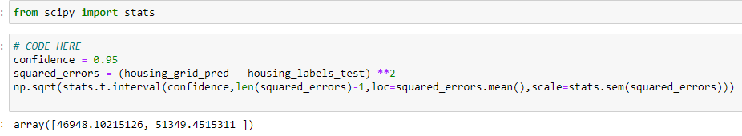
Model evaluation is done using appropriate metrics such as Mean Absolute Error (MAE), Mean Squared Error (MSE), Root Mean Squared Error (RMSE), R-squared, etc.
here we evaluated our final model using the rmse method once more but on the test set , then We will validated it using a 0.95 confidence interval using the “stats” library

